Slide 1
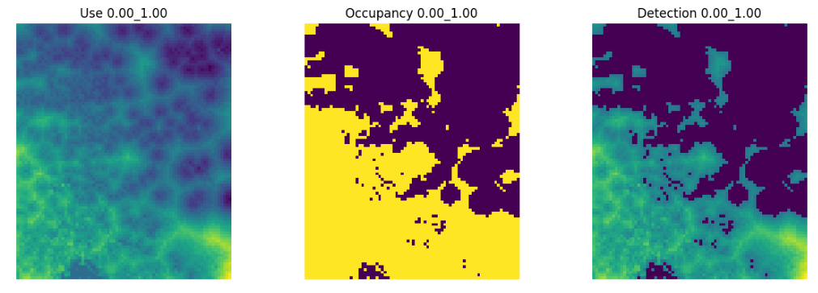
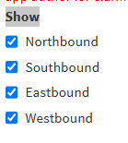
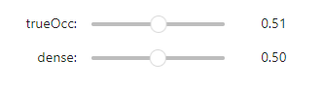
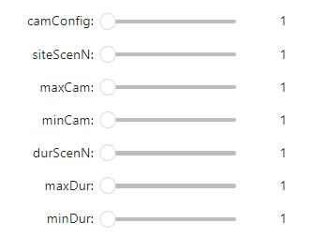
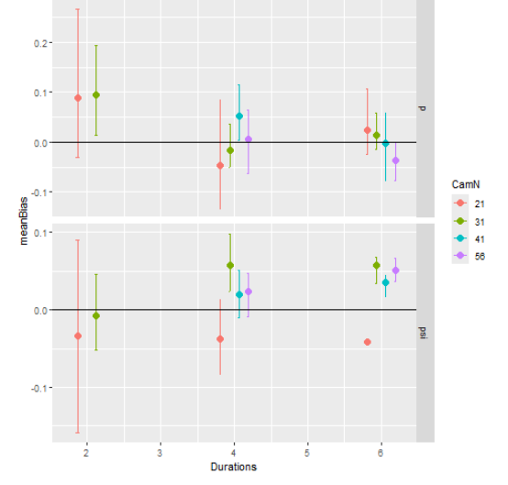
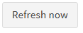
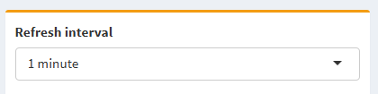
Occupancy – Spatial Power Analysis
[text box; there will need the be some info]
Eventually will need; can leave as
Camera config should be dropdown
This will eventually one map with overlapping layers + additional view options.
ERIC – do you have suggested MIN MAX for these sliders?
Maybe add a refresh button to avoid lag issues with populating instantanously
For these ^^^^ May want to leave a bit of space above each to provide info; for example….

